Slide 1

Aircraft Boarding Strategies Using Discrete Event Simulation
David Gyaraki: 582340 Lavin Pallas: 581619 Julius de Clercq: 582360

Slide 2
System description
Aircraft consists of 30 rows ,6 seats per row
Front boarding only
Passengers cannot pass each other , no back tracking
Every passenger needs to stand up for another passenger whose seat is in the same row
Aisle cell can fit more than one person at the same time to allow passengers to reach their seat
Passengers are assumed to be aware of their seat number and cannot change it
There is assumed to be sufficient luggage for each passenger

Slide 3
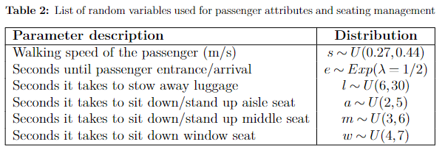

Slide 4
Boarding procedure snapshots for each boarding strategy

Slide 5
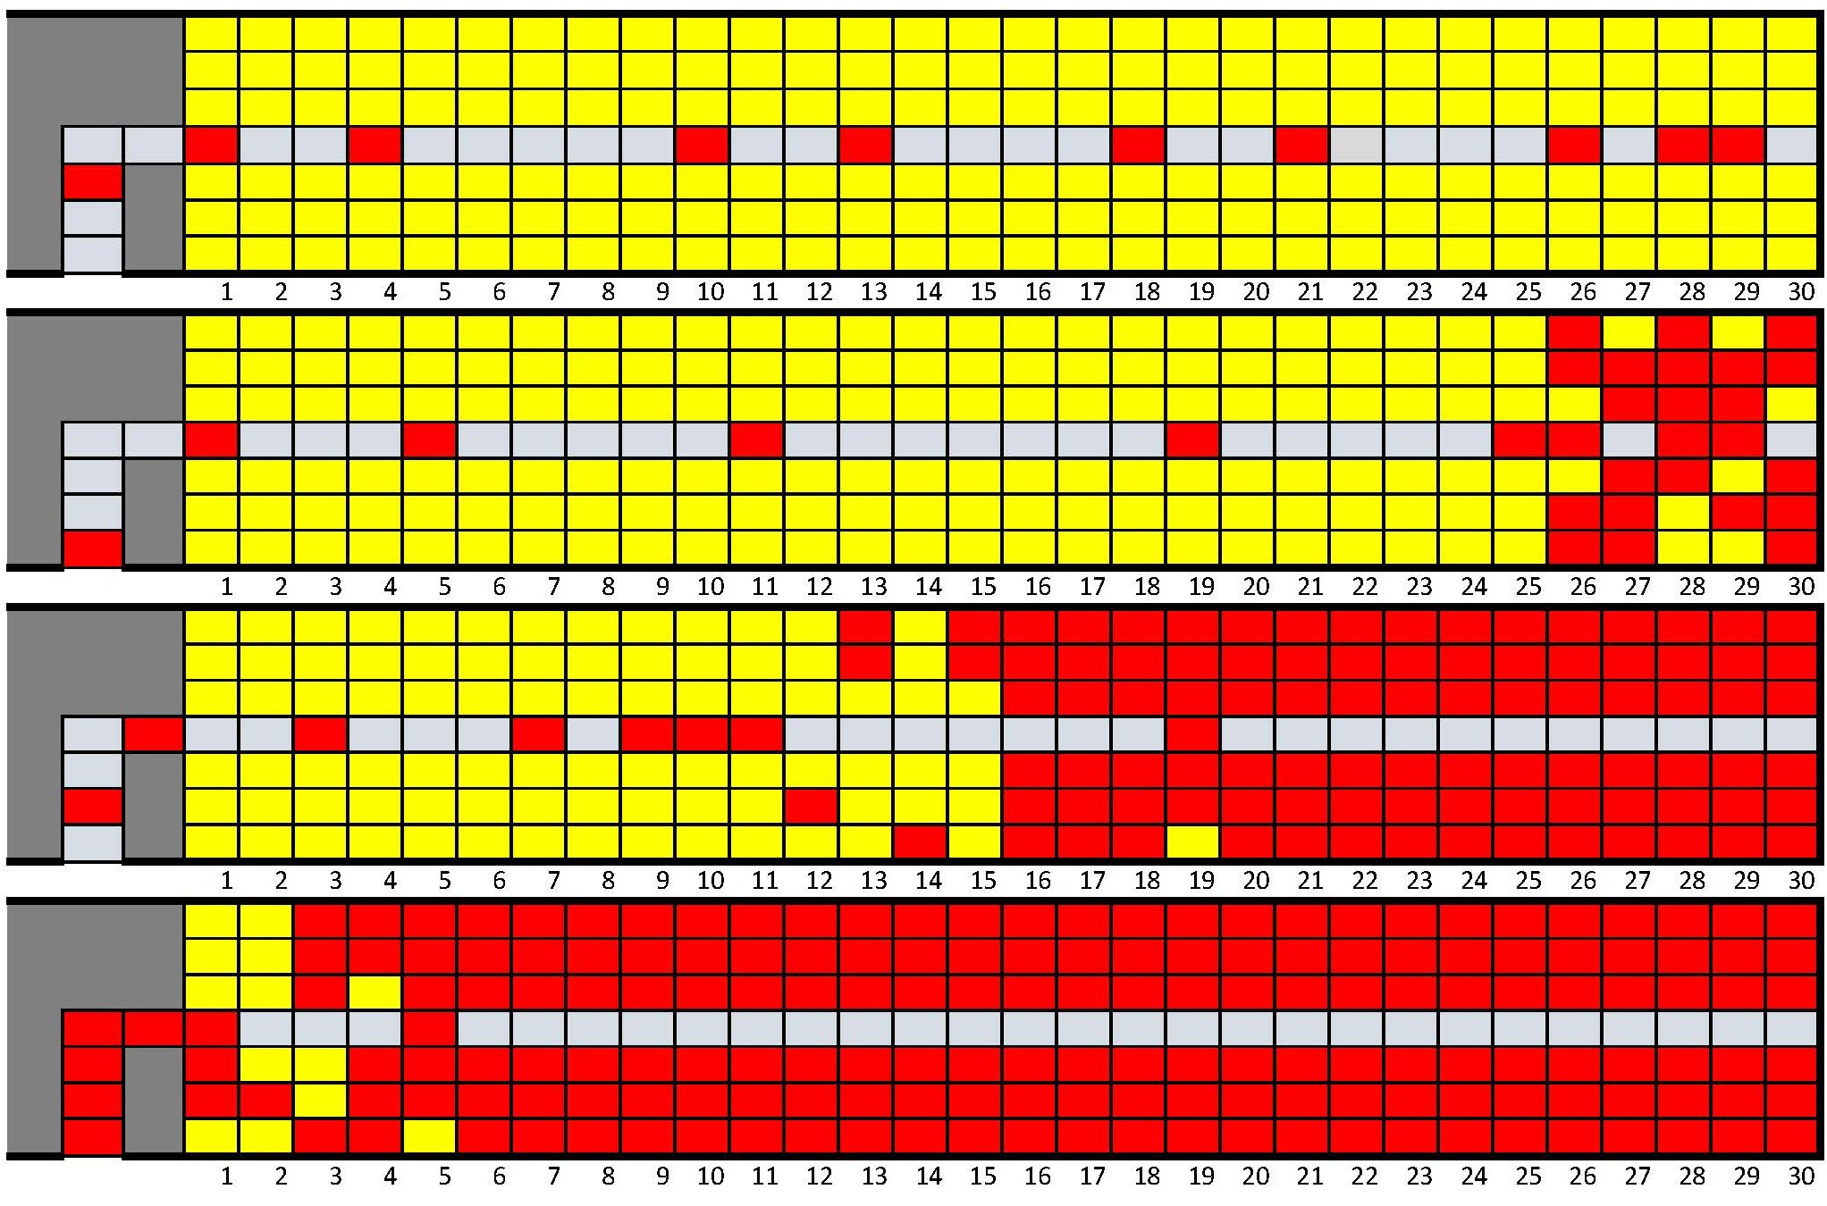
Back to front strategy

Slide 6
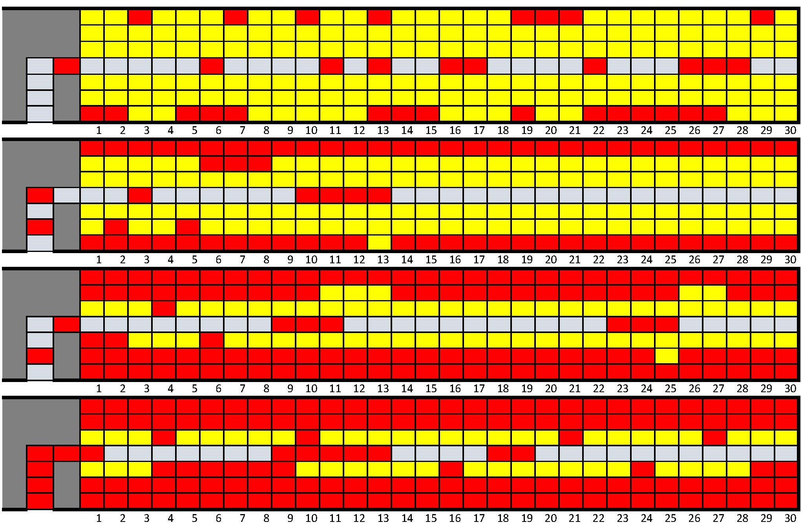
Window middle aisle strategy

Slide 7
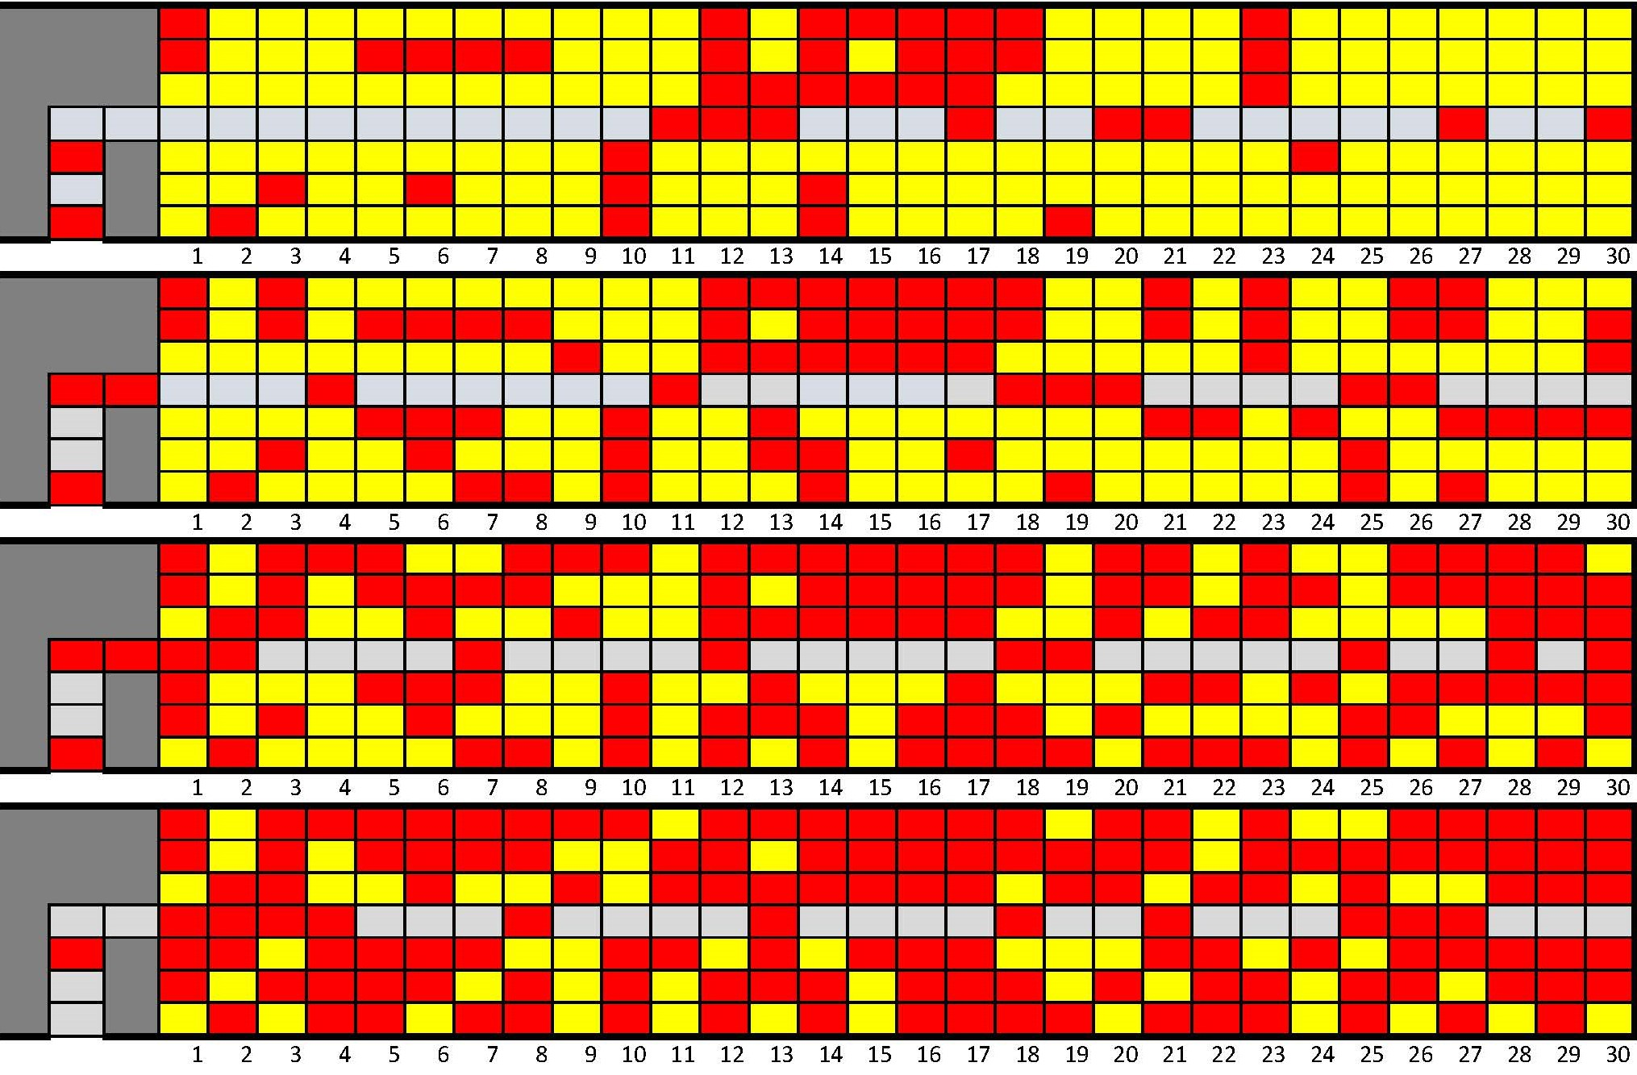
Random strategy

Slide 8
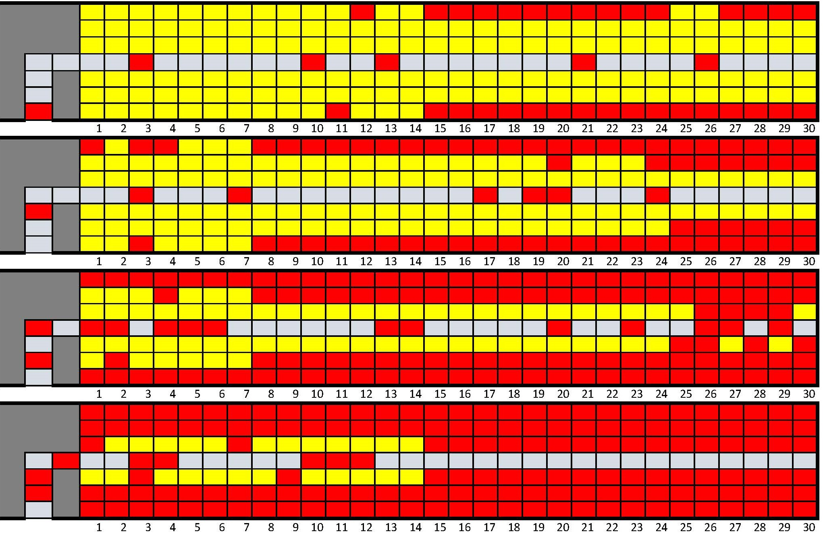
Reverse pyramid strategy

Slide 9
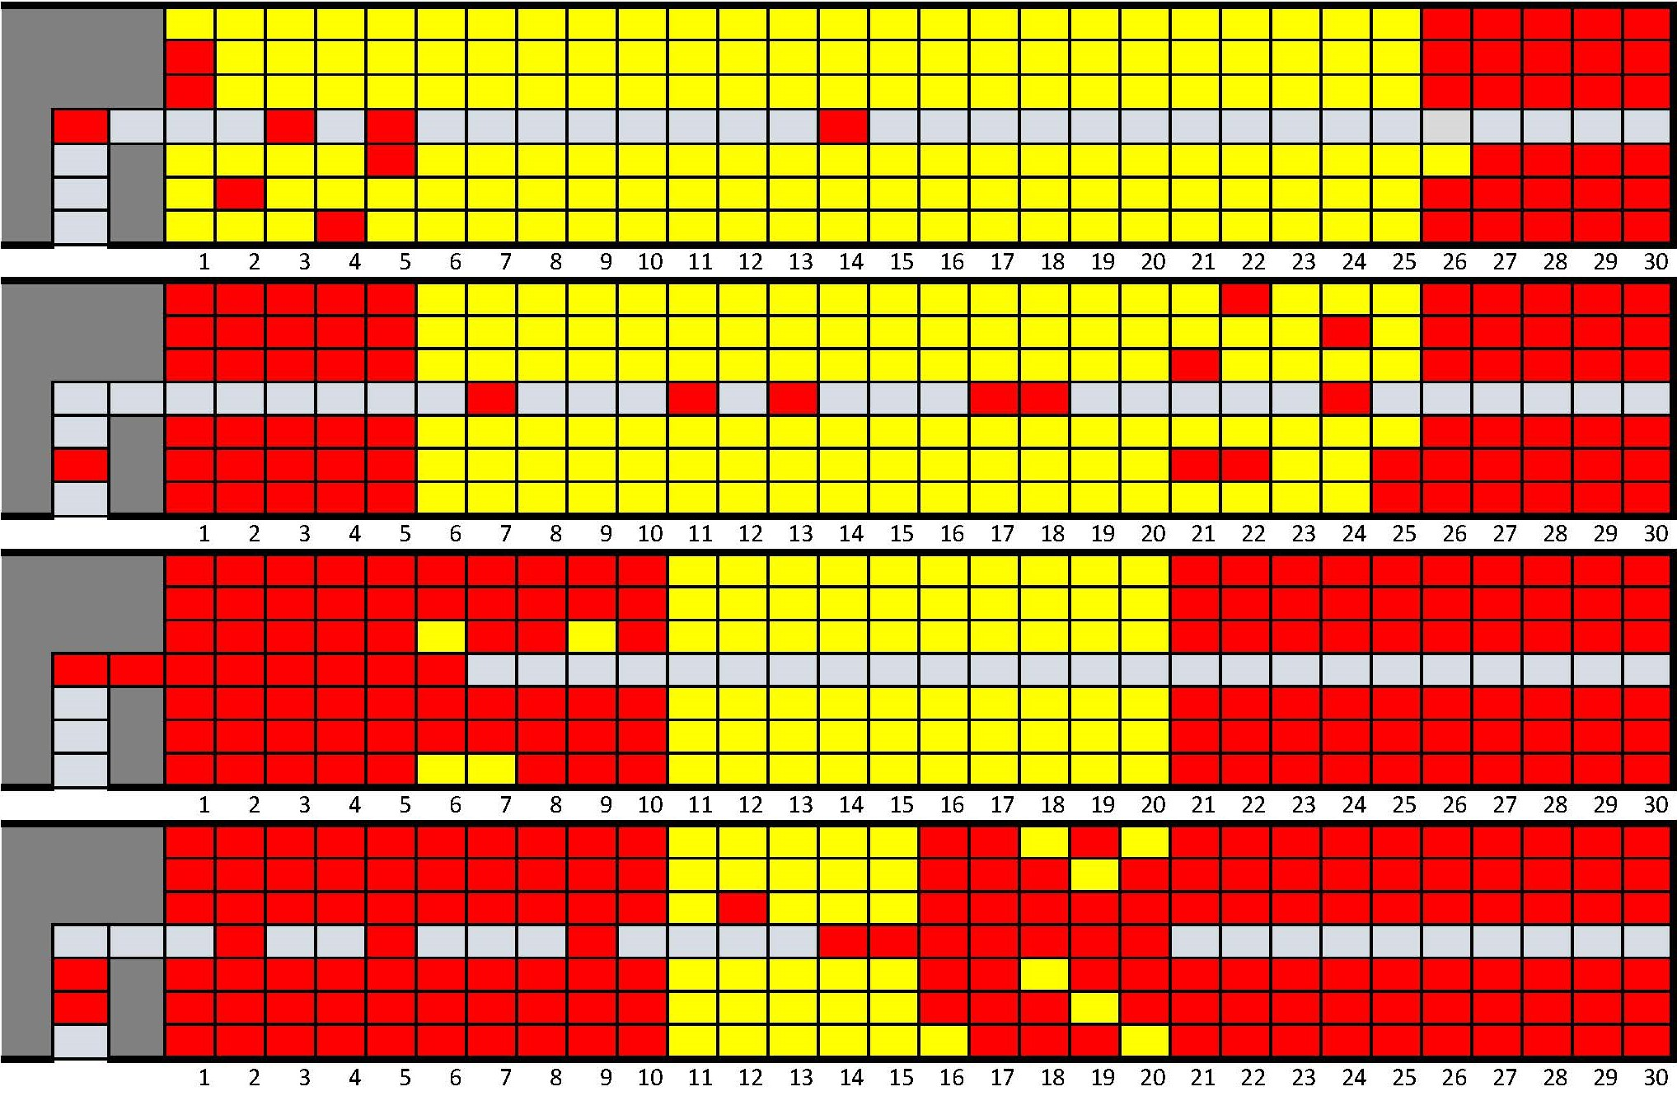
Rotating zone strategy

Slide 10
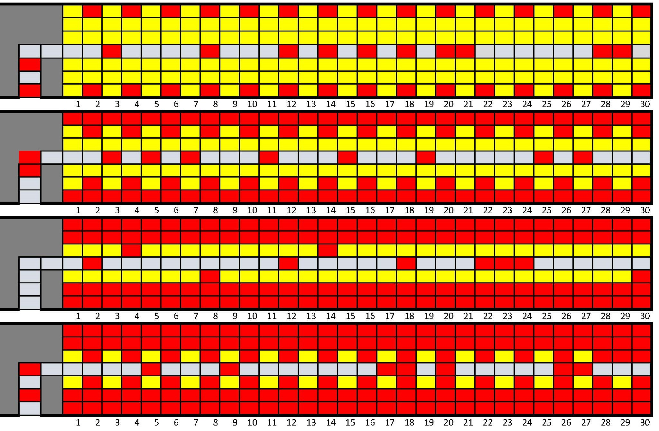
Optimal strategy

Slide 11
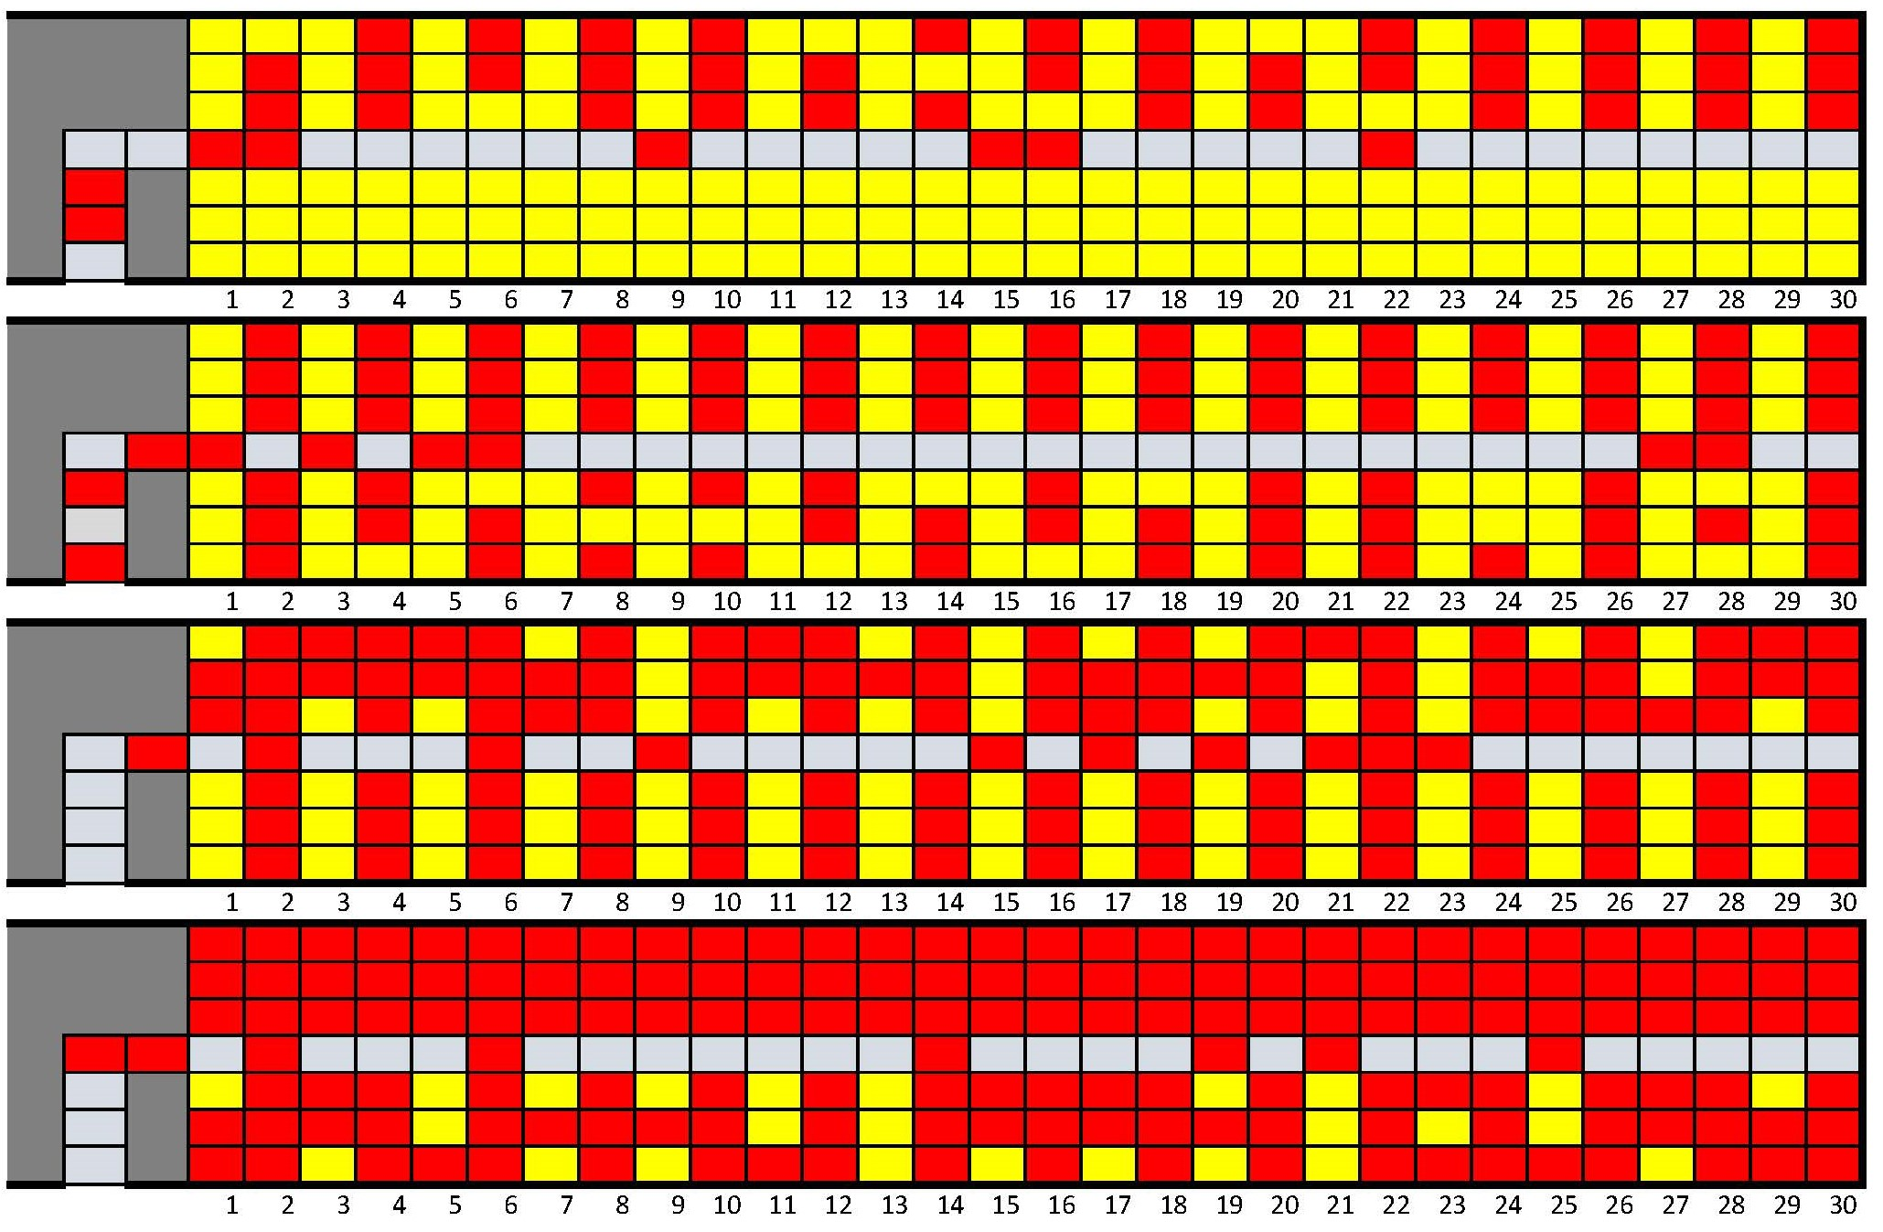
Practical optimal strategy

Slide 12
Results

Slide 14
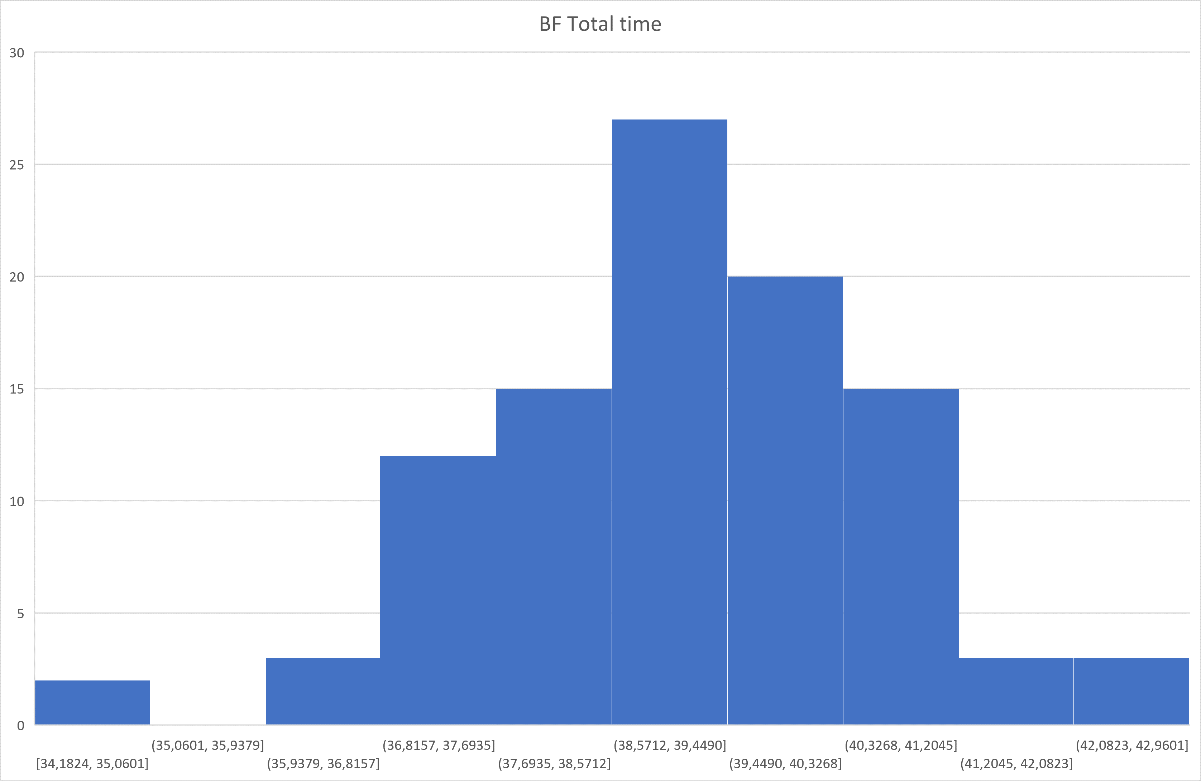

Slide 15
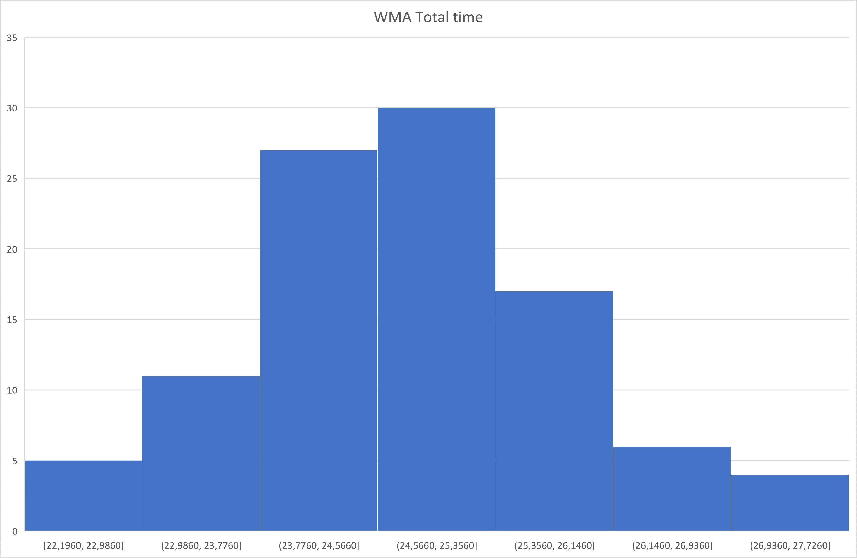

Slide 16
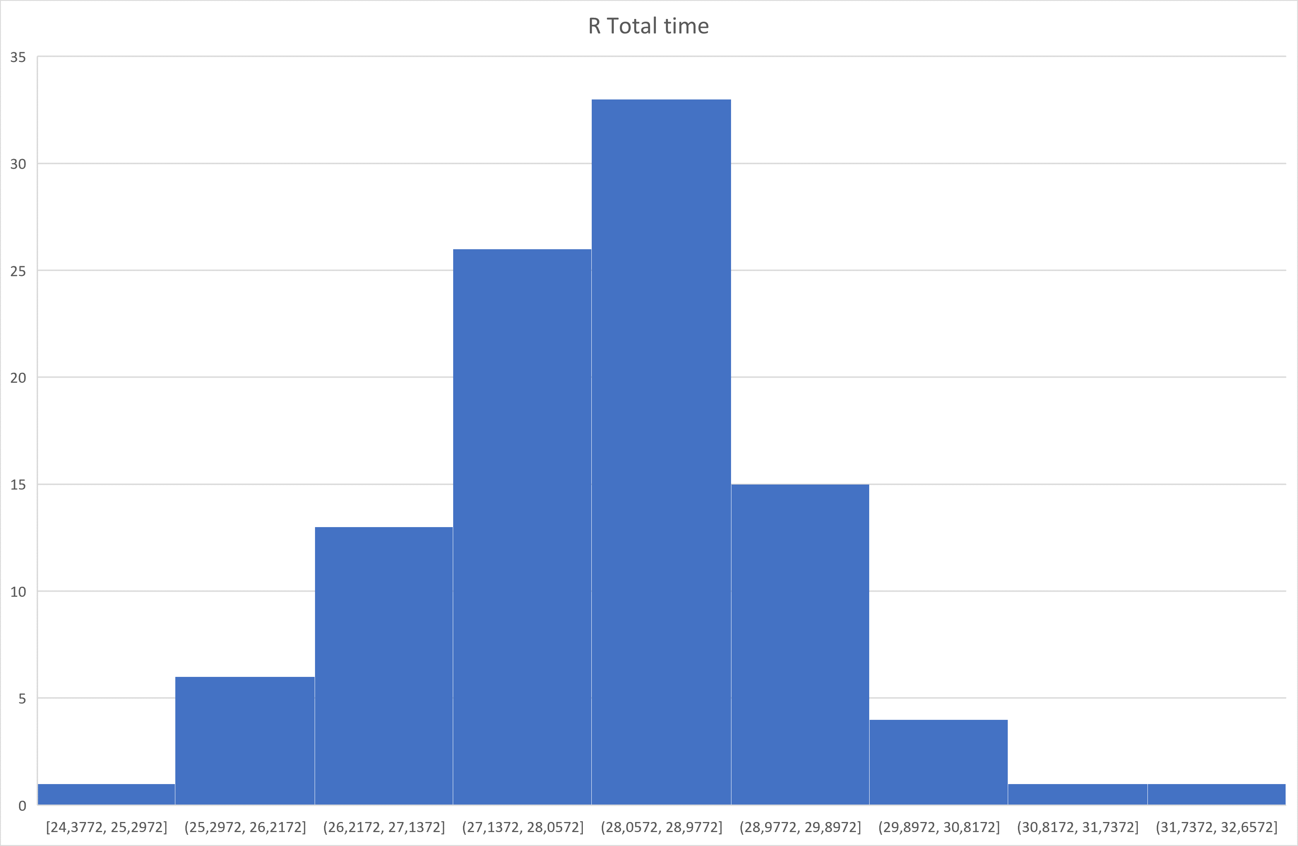

Slide 17
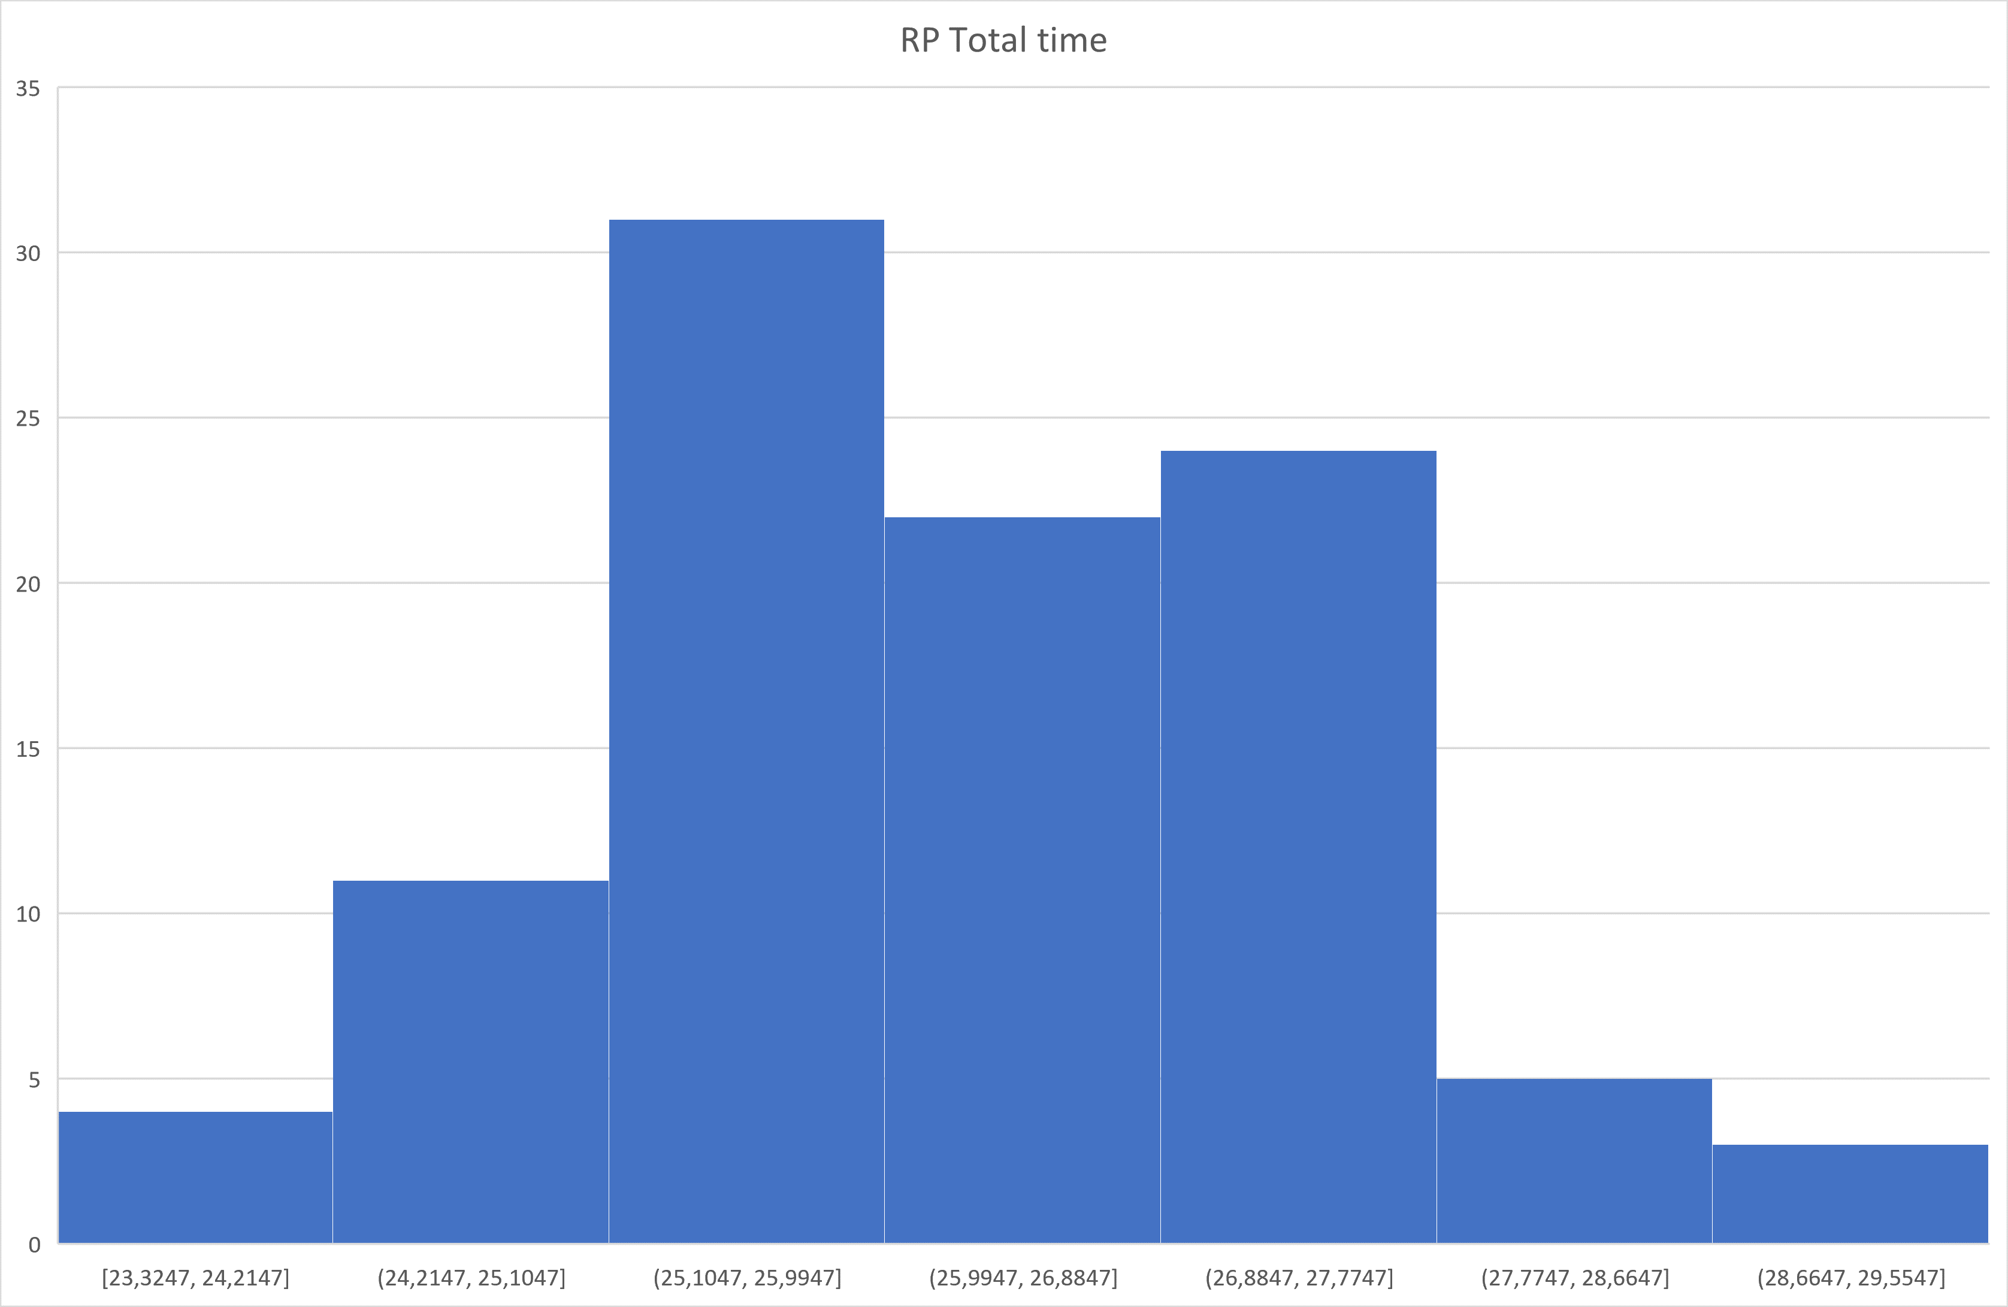

Slide 18
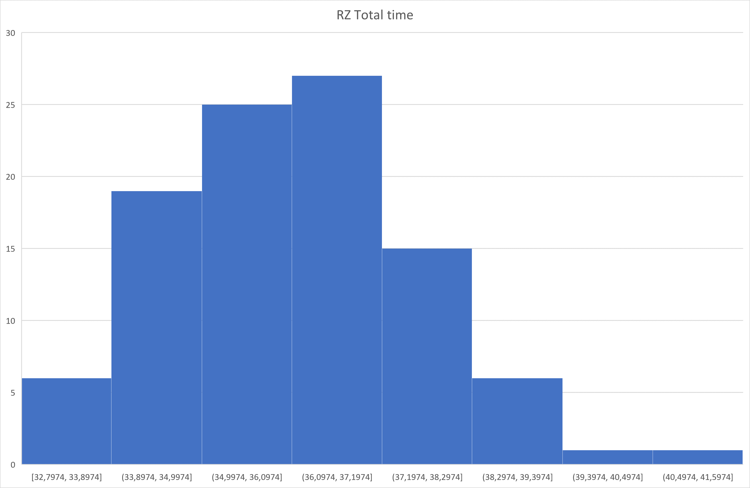

Slide 19
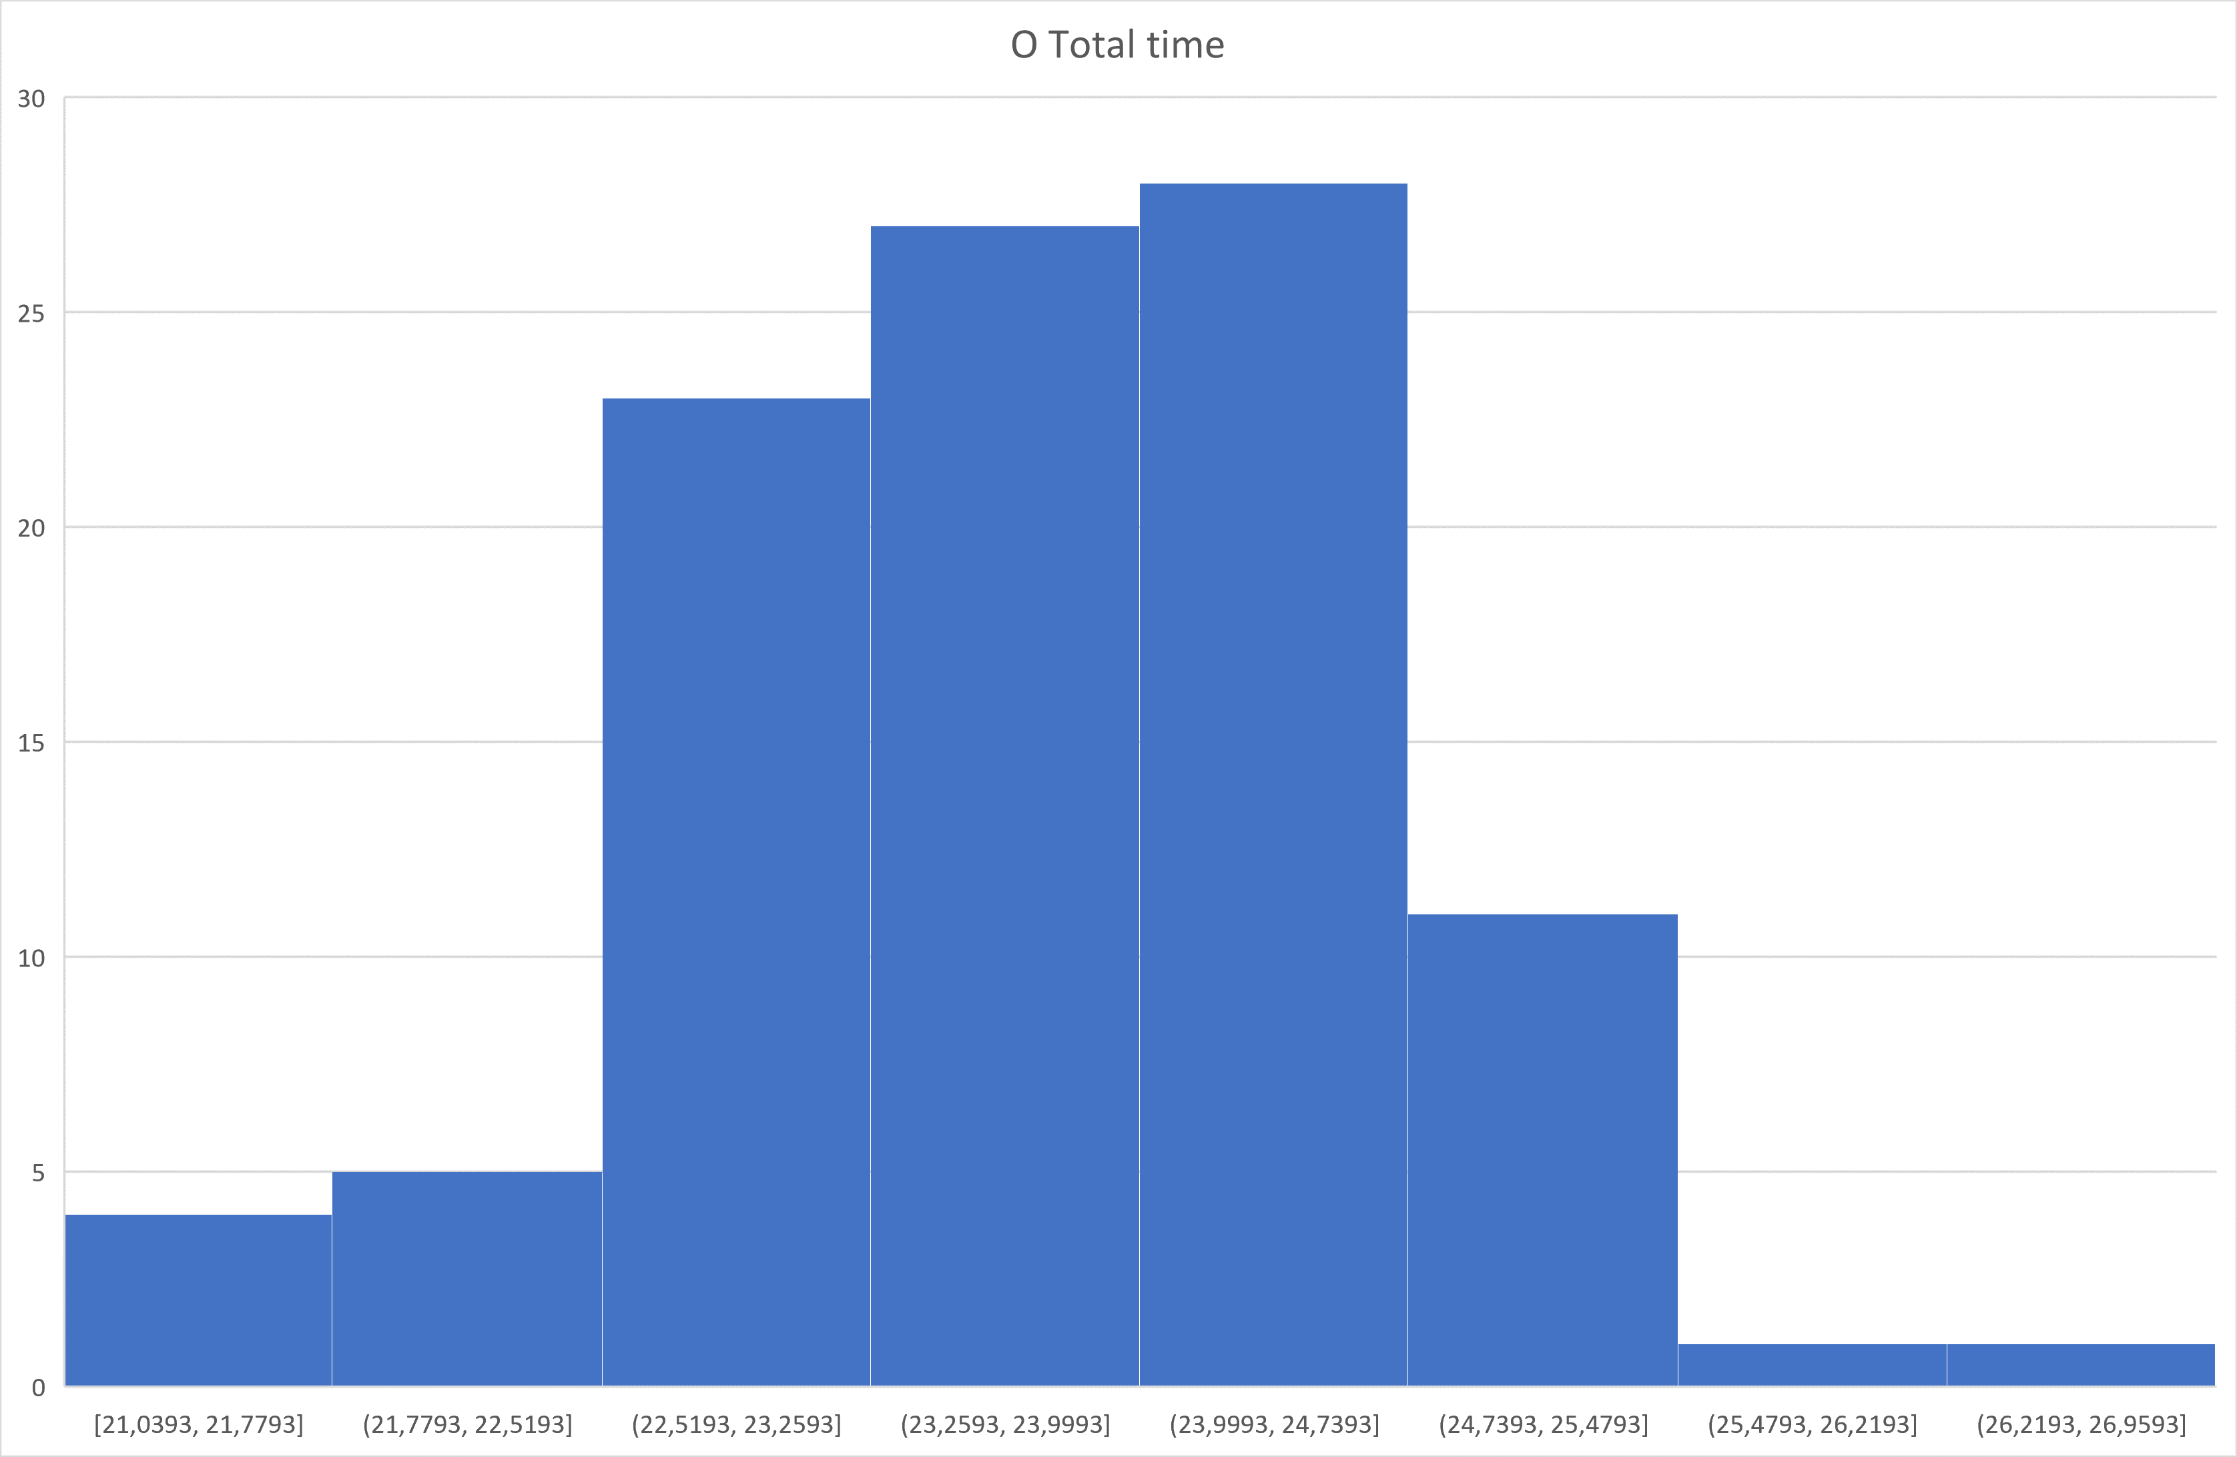

Slide 20
